Slide 1
Shape Optimization of Submarines

Slide 2
Model
Objective function (J) = f(D) with design variables X
𝜞_{S}
D - Drag Force on the body
X - Coordinates of the boundary of the body (𝜞_{B})
𝜞_{B}
Ω
𝜞_{D}
𝜞_{U}
𝜞_{S}

Slide 3
Optimisation Algorithm
1
2
Results: u,p
3
Results: u*,p*
Initial Model with Coordinates X⁽⁰⁾
Solving NSE with BCs
Solving Optimality Criterion Eqn with BCs
OpenFoam
OpenFoam
4
(Not
Satisfied)
Compute grad(J) = f(u,p,u*,p*)
Update Coordinates X^{(i+1)} using Weighted Gradient Method
Convergence Criteria
| X^{(i+1)} - X^{(i)}| < 𝜺
1
Continue from Step 2
5
6
Prog. Language
(Satisfied)
Prog. Language
Optimal Model with X^{(f)}
7

Slide 4
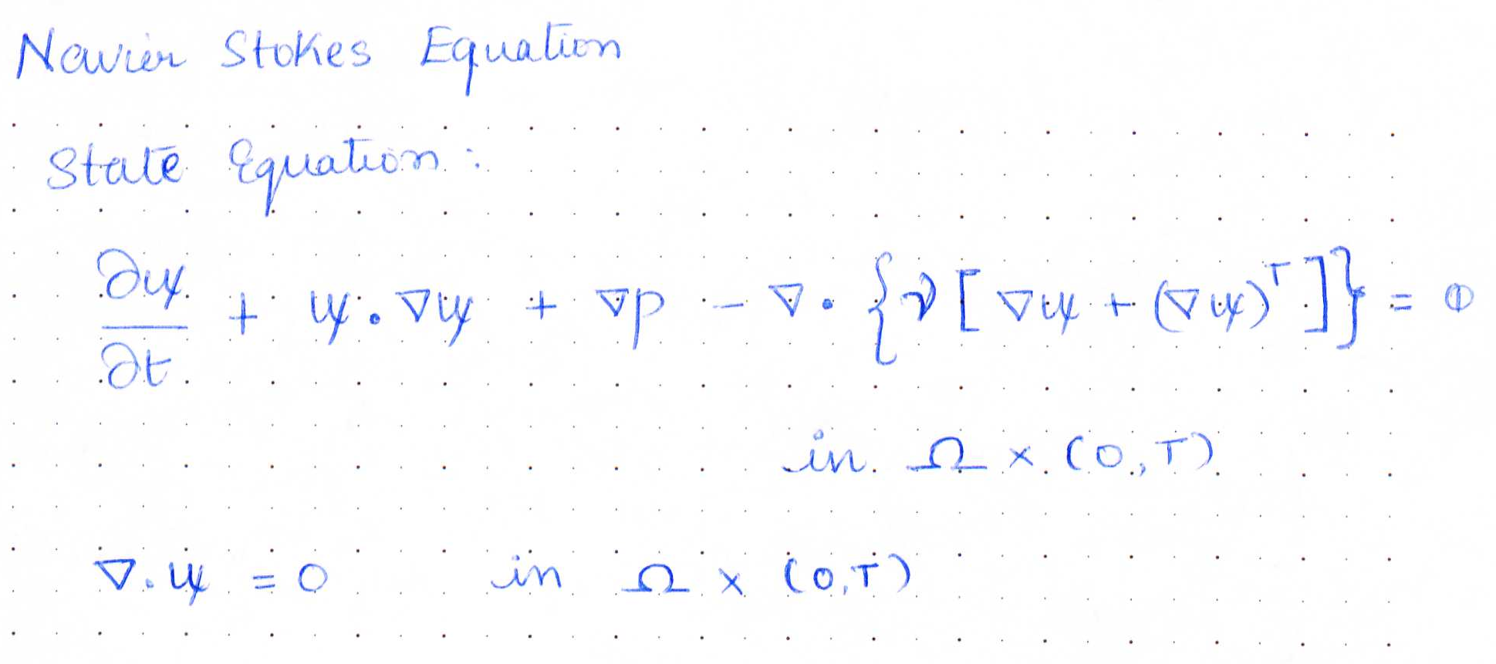
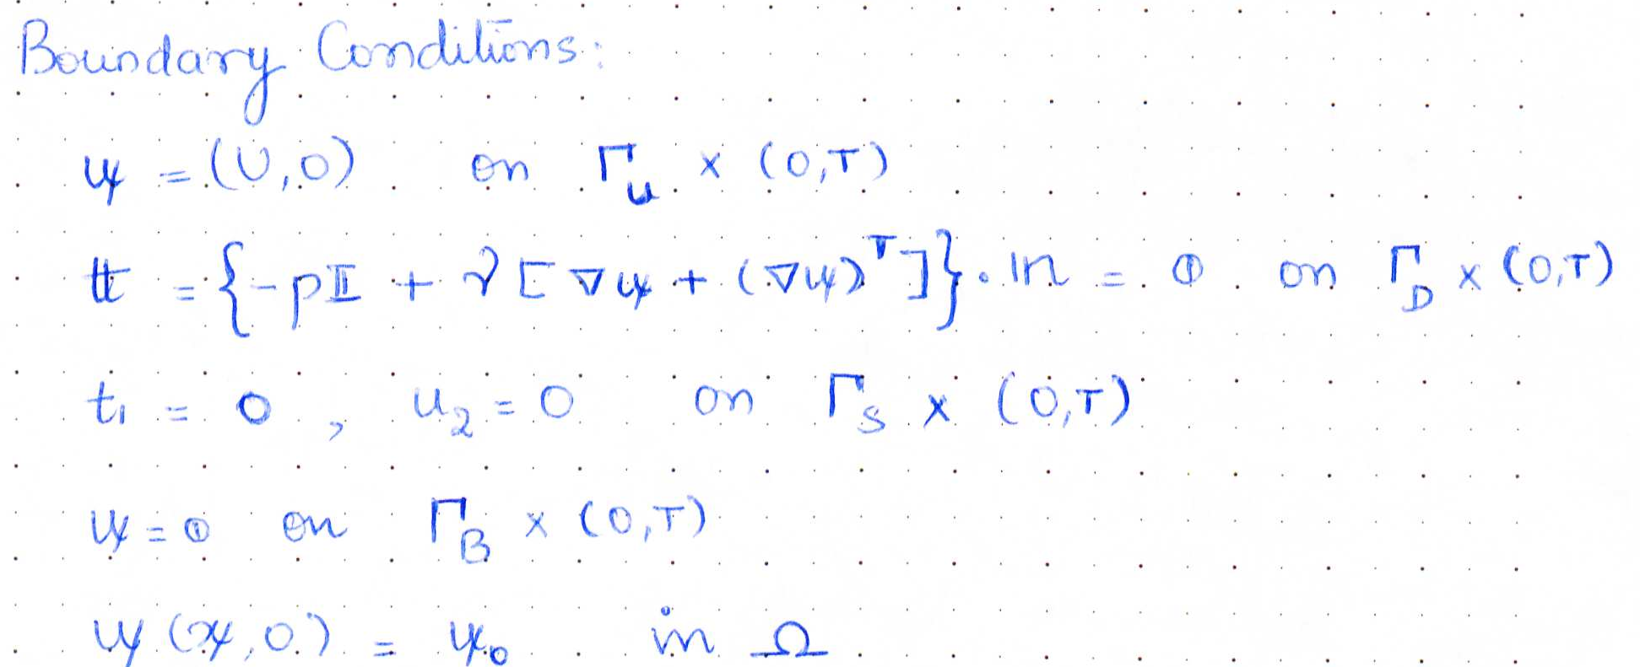
Navier Stokes Equations

Slide 5
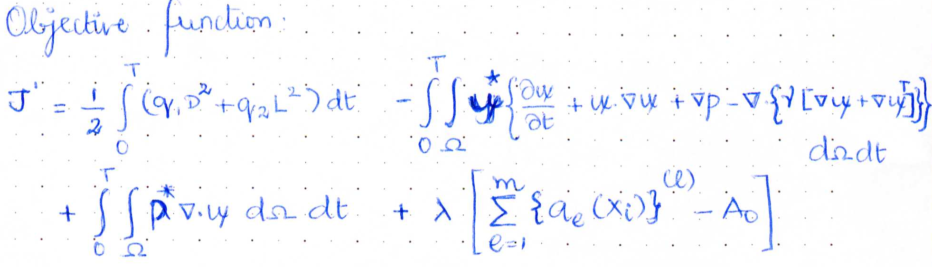
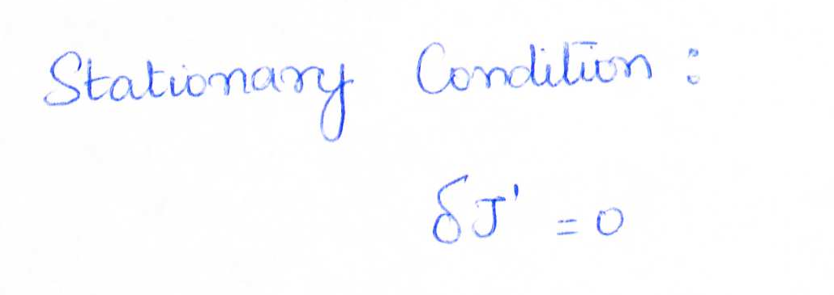
Optimality Criterion

Slide 6
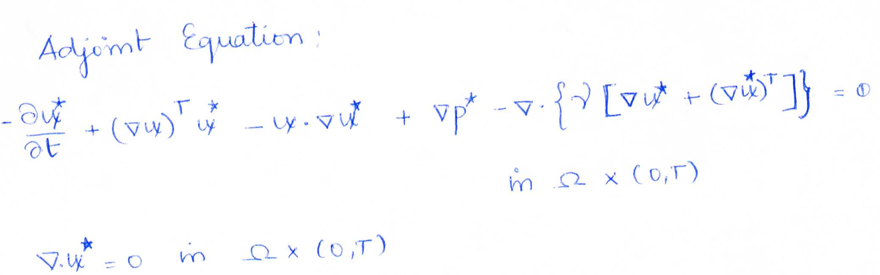
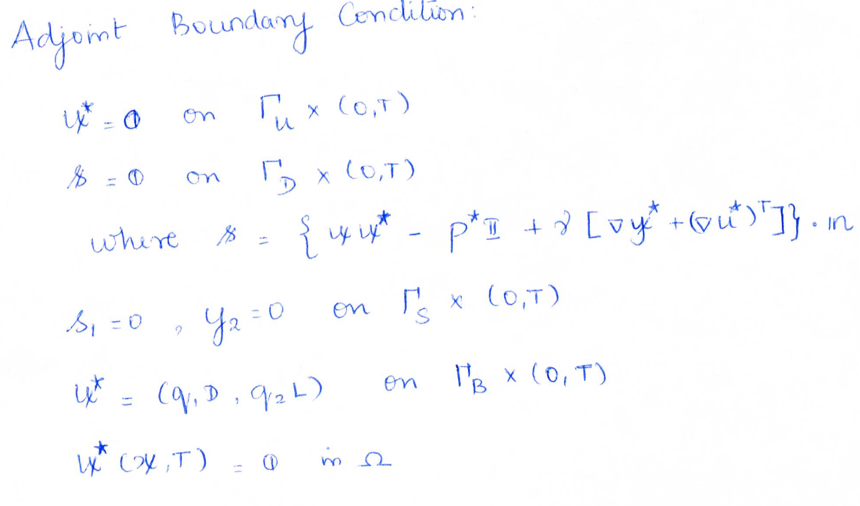
Optimality Criterion Equations

Slide 7
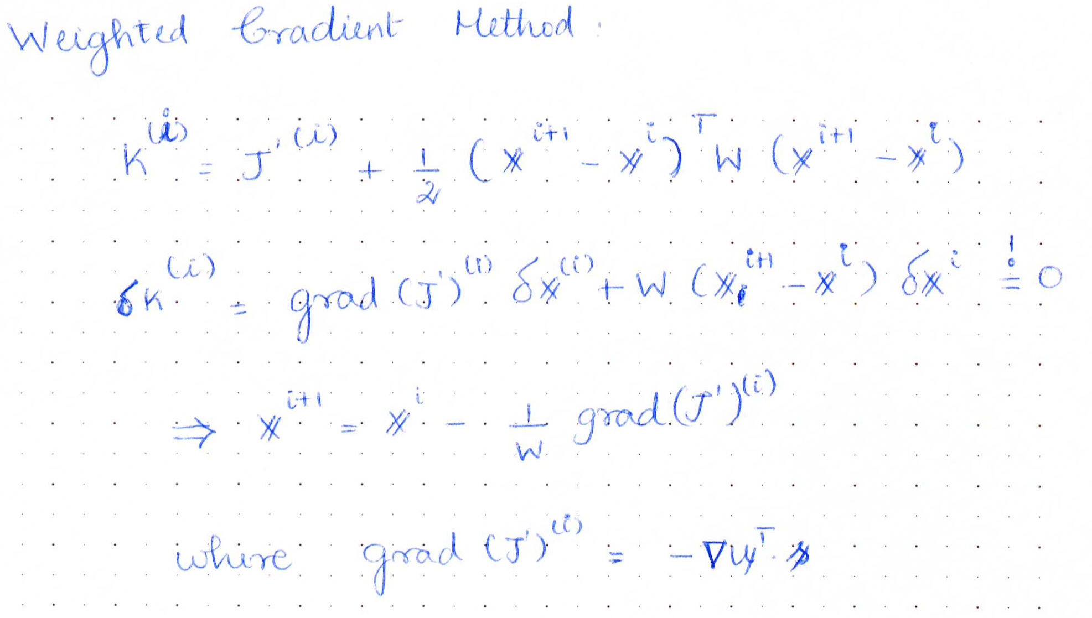
Update of Coordinates

